Slide 1
Ring artifacts removal in iMars3D

Slide 2
Methods
Correct Sinograms
Munch (wavelet-Fourier filtering)
Ketcham (median filter)
Correct reconstructe images directly (tomopy)

Slide 3
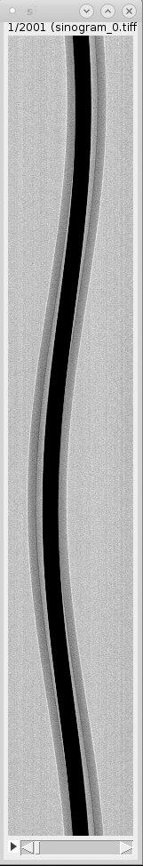
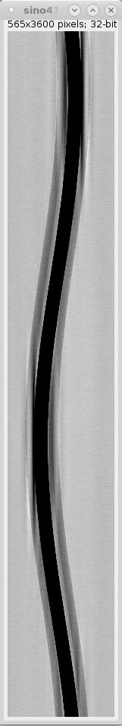
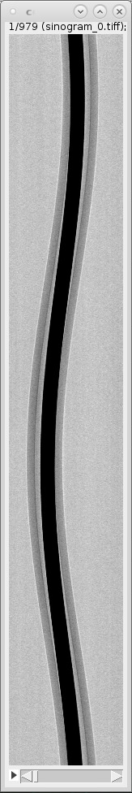
Comparison of sinograms: Ketcham vs Munch - U fuel spheres
Original
Munch(tomopy)
Ketcham (iMars3D)

Slide 4
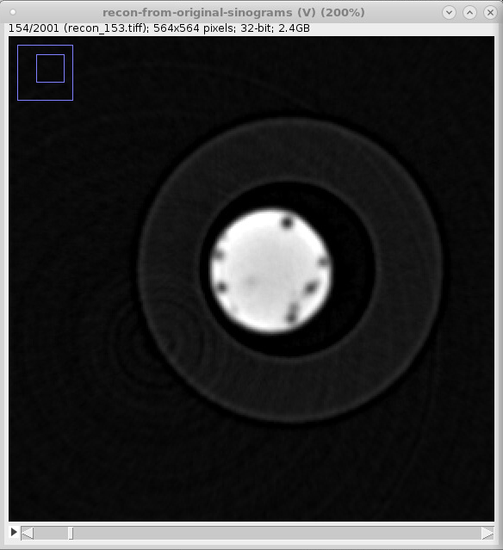
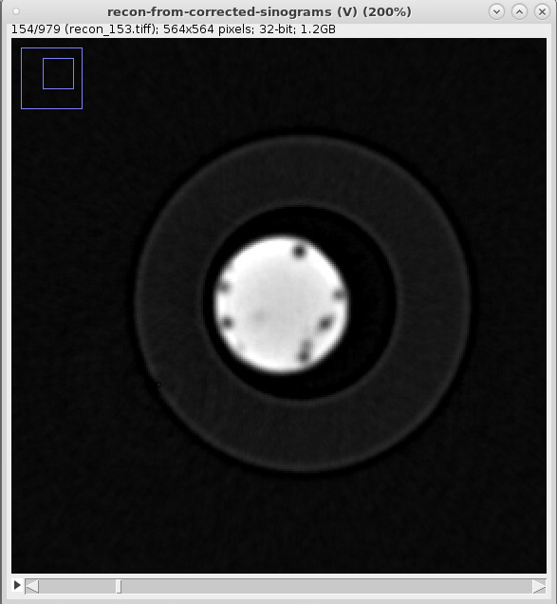
Comparison: Original vs Ketcham - U fuel spheres
Original
Ketcham (iMars3D)

Slide 5
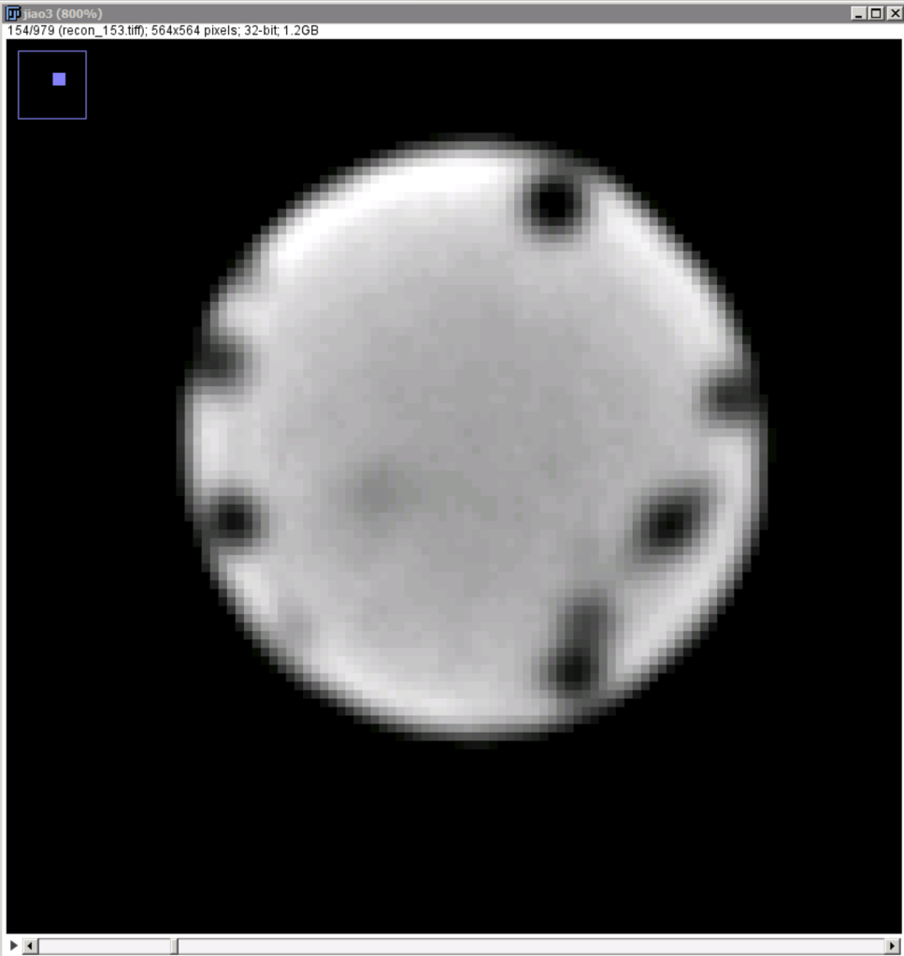
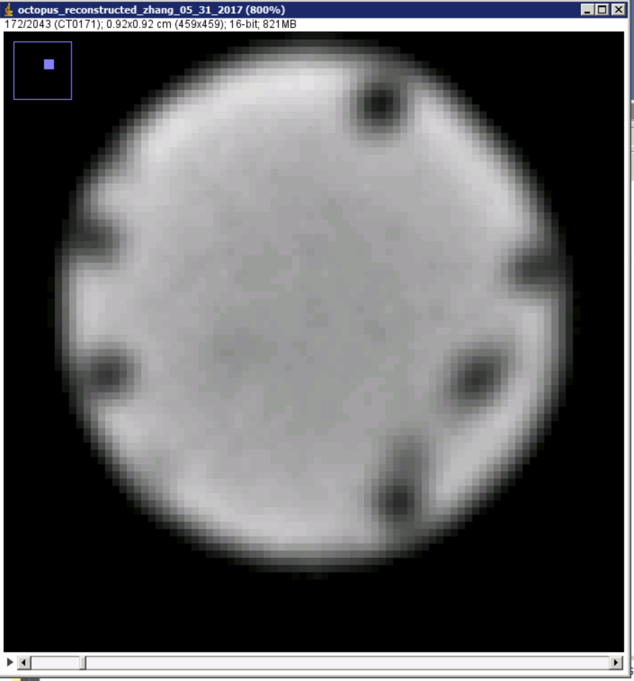
Comparison: Octopus vs Ketcham - U fuel spheres
Octopus
Ketcham (iMars3D)

Slide 6
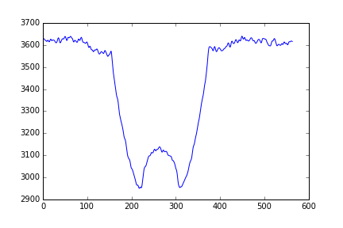
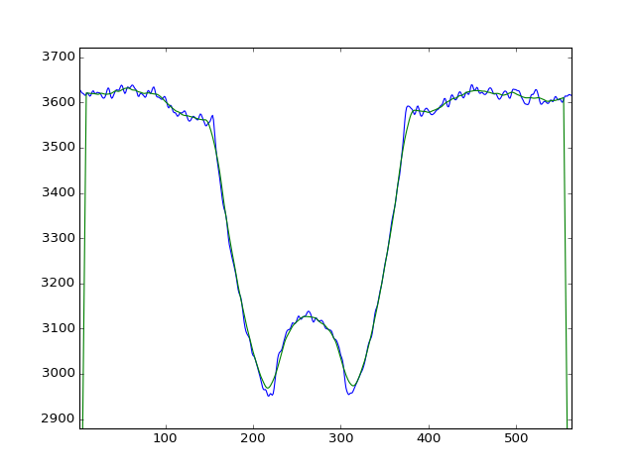
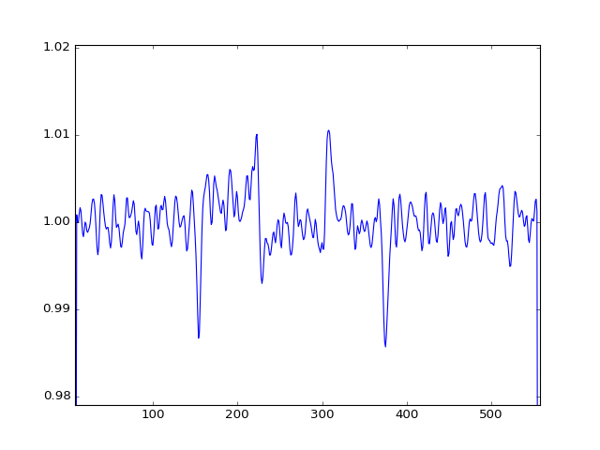
Ketcham method
Sum over angle
Average using a moving window
Angle
Correction = Original/Averaged
Pixel

Slide 7
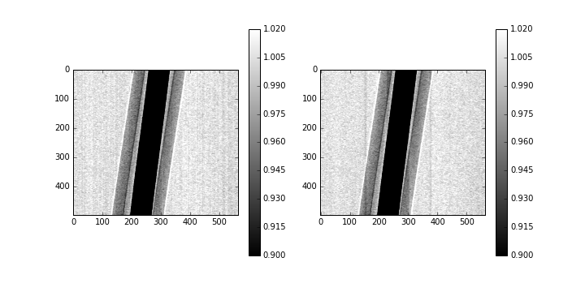
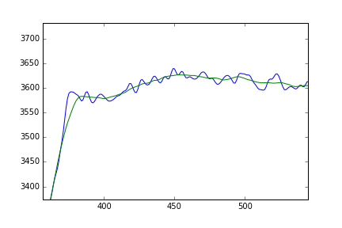
Ketcham method - Edges?
Large error shows up at the edges
New artifacts

Slide 8
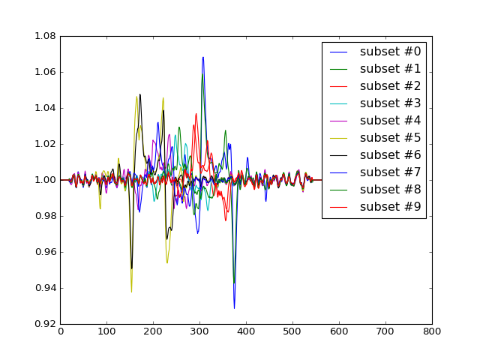
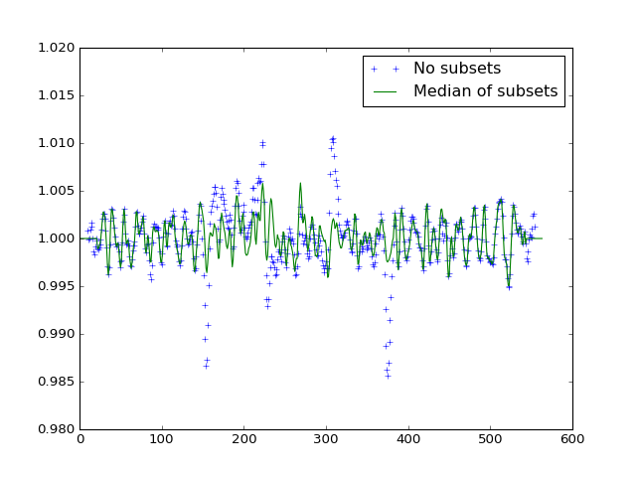
Ketcham method - median of subsets
Divide sinogram into subsets

Slide 9

Ketcham method

Slide 10
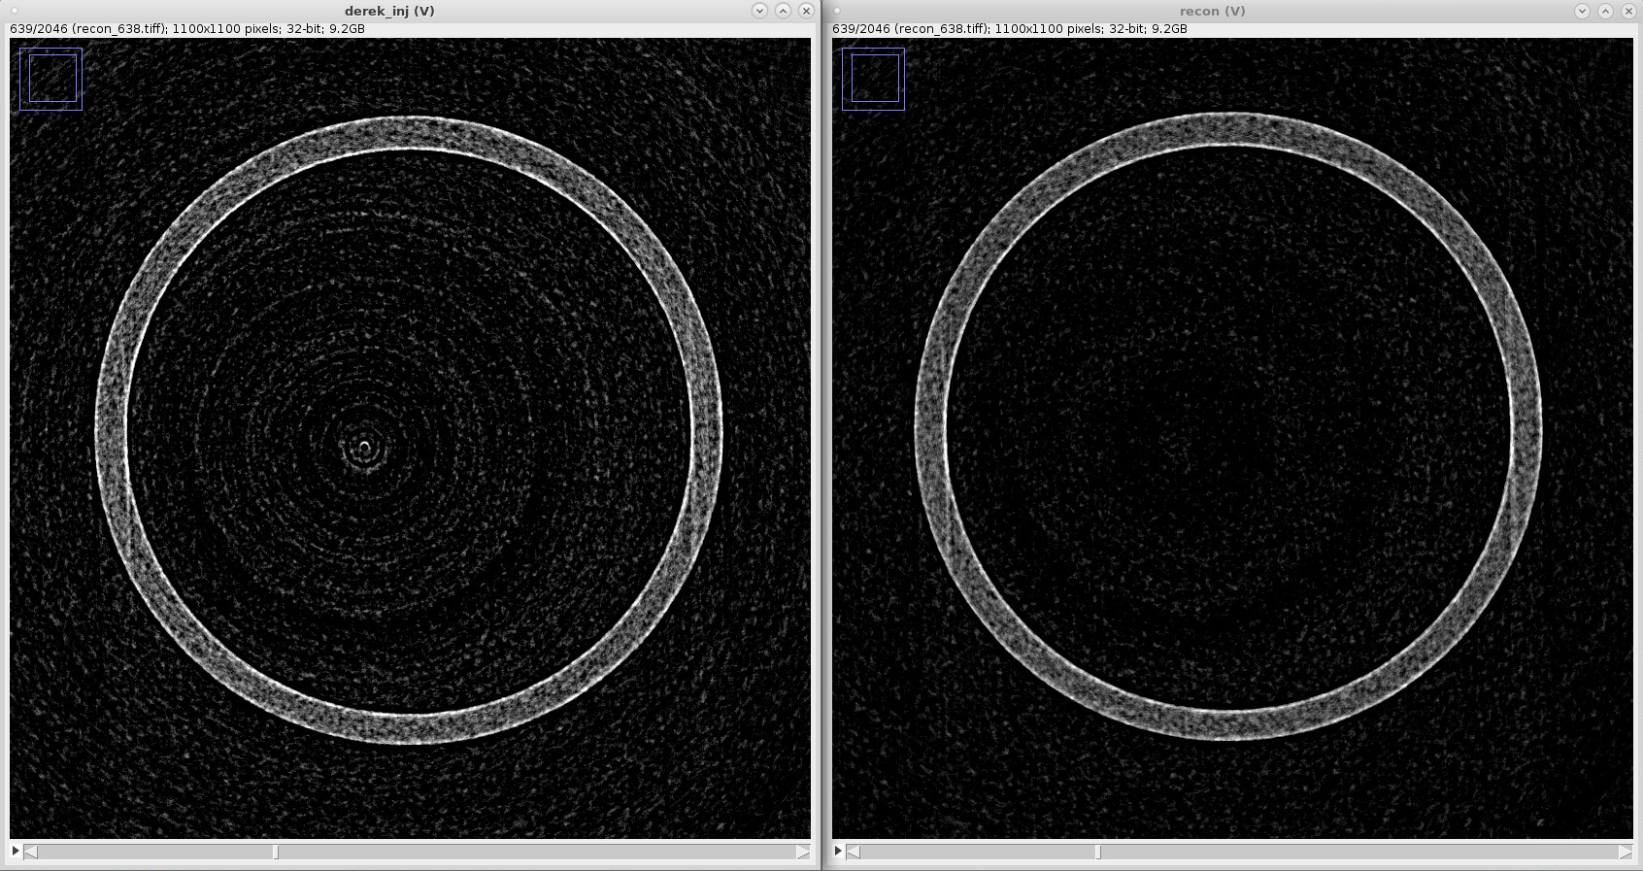
Comparison: Original vs Ketcham - injector
Original
Corrected

Slide 11
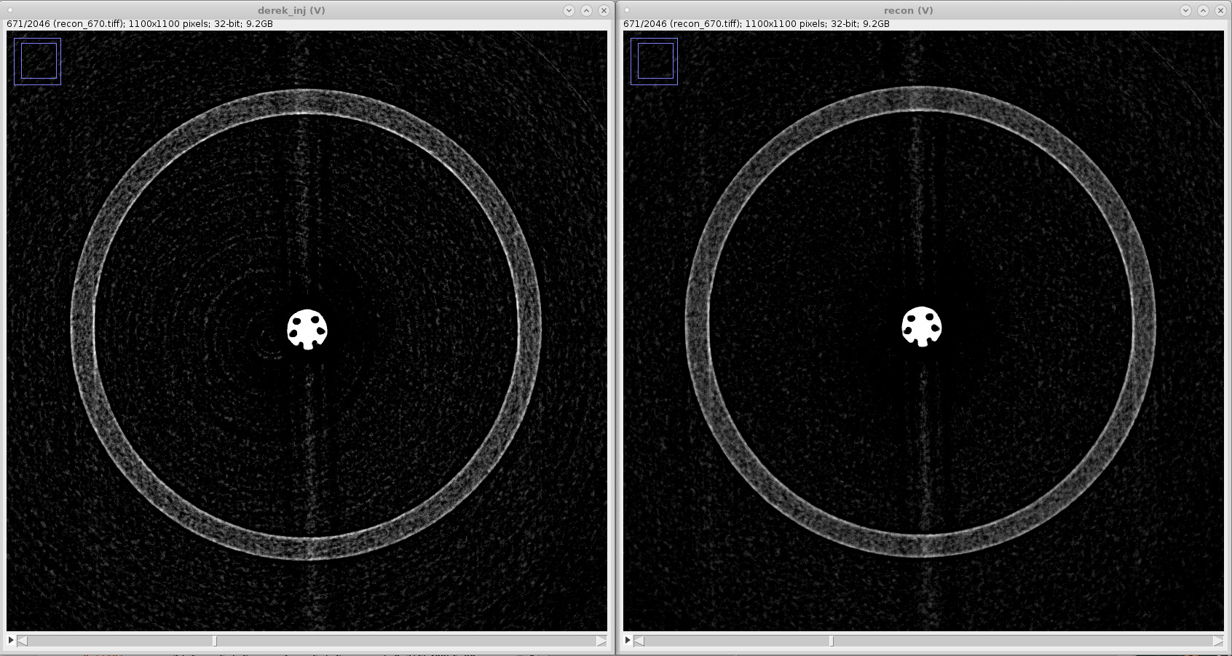
Comparison: Original vs Ketcham - injector
Original
Corrected

Slide 12
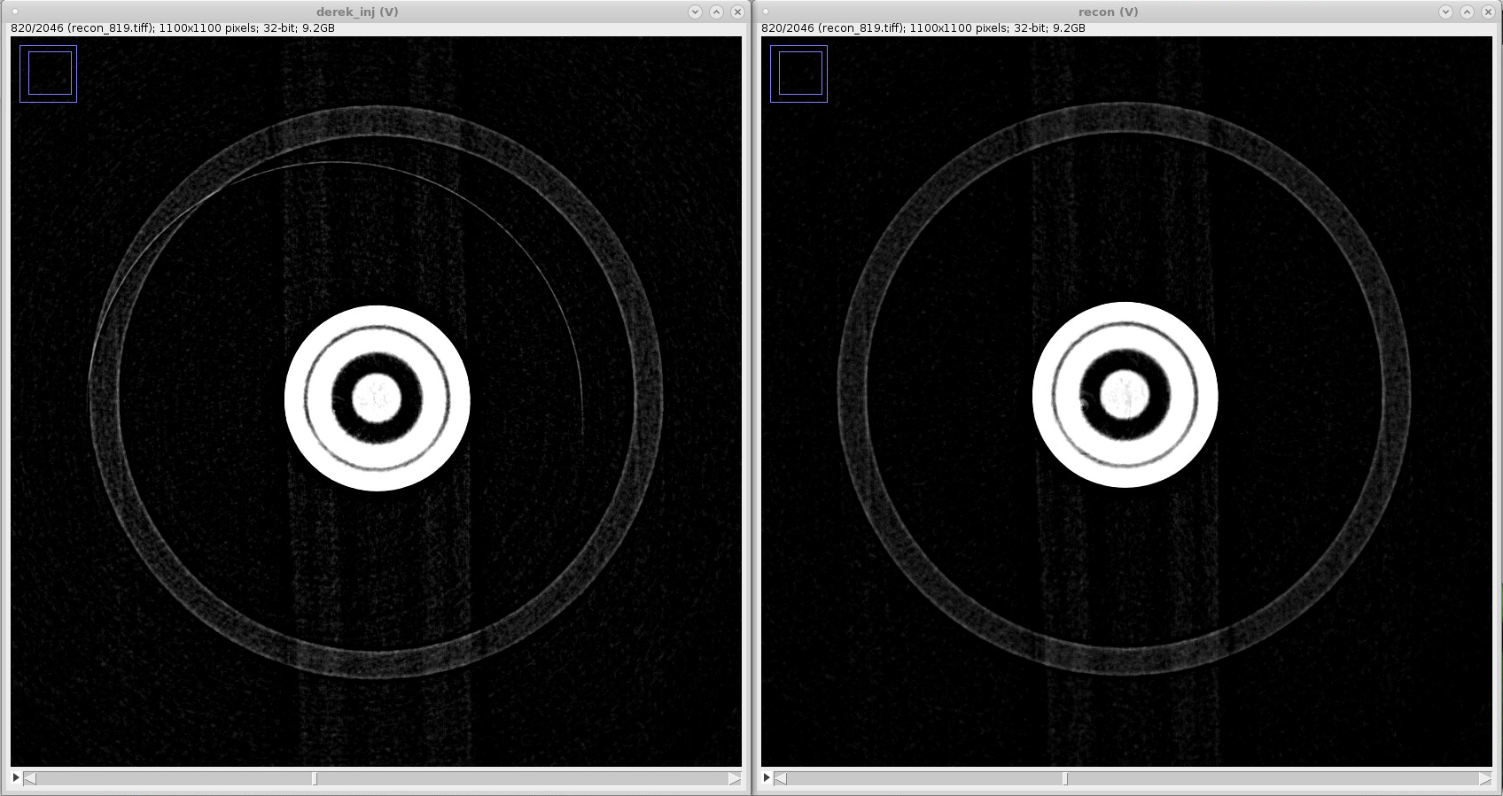
Comparison: Original vs Ketcham - injector
Original
Corrected

Slide 13
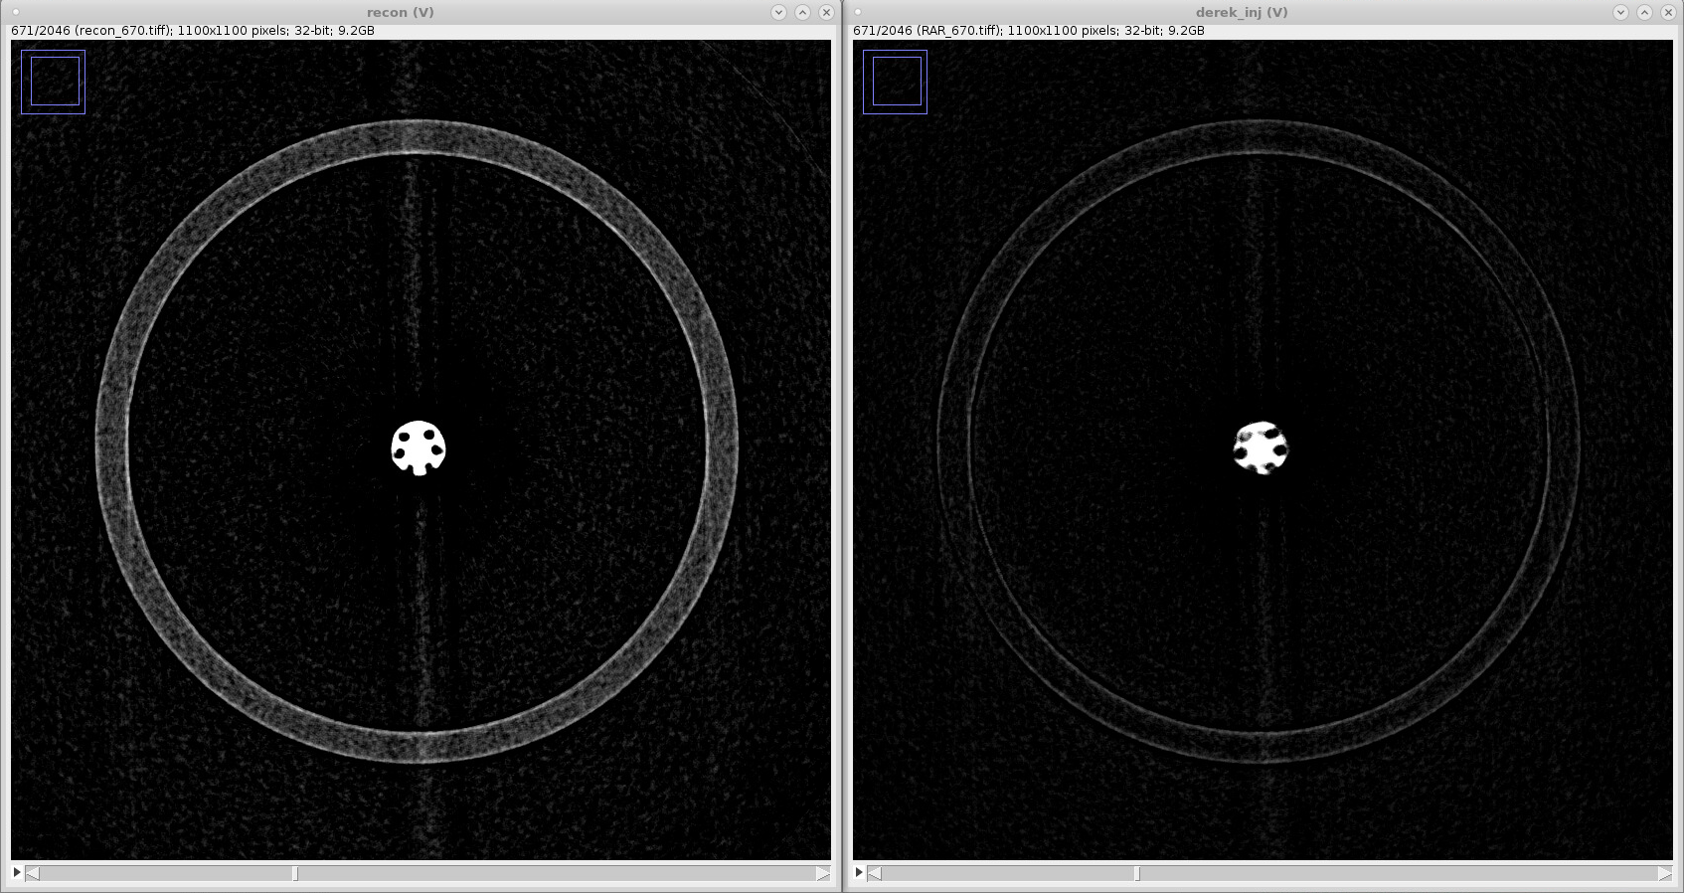
Comparison Ketcham vs Tomopy - injector
Corrected using Ketcham algorithm
Corrected using tomopy algorithm

Slide 14
Summary
The Tomopy implementation of Munch method introduces artifacts in sinograms.
The Tomopy postprocessing method removes features from the reconstructed images.
Ketcham method works well for these cases
U fuel spheres
Injector

Slide 15
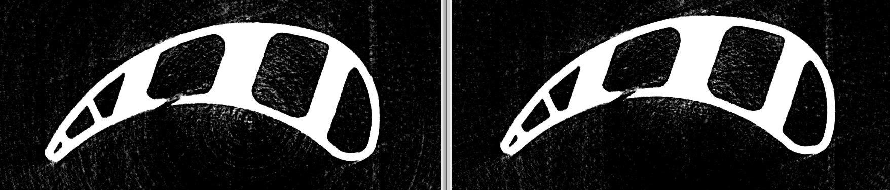
Comparison: Original vs Ketcham - turbine
Original
Corrected

